Slide 1

Graph Theory and its Applications
Measures of cohesiveness : degree distribution and diameter
Dr. Arti Arya
Department of Computer Science
and Engineering

Slide 2

Graph Theory and its Applications
Network formation first step - Dyad, Triad, Bridge
Dr. Arti Arya
Department of Computer Science and Engineering

Slide 3
Graph Theory and its Applications Disclaimer
The course slides are prepared by Prof. BhaskarJyoti. But various additional inputs are added by me from various reliable resources from Foreign and Indian Universities as well as from sites.
Notes:
Ok. Having said that, lets get back to what we were speaking about.
Input devices. We have seen that the virtual reality eco system largely encompasses three fundamental components that include
HMD – head mounted devices that give you immersive VR experience, we saw some examples in the last class like the HTC VIVE, Oculus Rift, Samsung gear and so on. Some of you have also used few of these and experienced it for a few minutes.
And the second components is the GTD or the Gesture Tracking Devices. We saw a video of Xsense IMU sensors that can accurately estimation the position and orientation of a dancer. we will in the next hour see how these gesture tracking devices work and what are the various technicalities that go into tracking. I will try to keep it as non-mathematical as possible, as the mathematics behind it can get pretty messy and complicated. However, if you are interested in the mathematical aspects, I will be more than happy to discuss.
On the screen you can see that a 3 directional coordinate system is depicted. The 3 primary axes of a 3d coordinate system is X, Y and Z axis. Hear I would like to know where, when and why in your past have you encountered 3 dimensional coordinate system.
Give some time to the students to ponder on
Ok, if I tell you, I have encountered 2 dimension in images, drawings, sketch and so on. While I have encountered 1 dimension when I want to know the temperature currently or current time or something like that. Similar, where and when have you encountered 3D, either consciously or subconsciously.
Explain the roll pitch and yaw concepts.
Degree of freedom

Slide 4
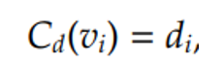
Graph Theory and its Applications
Centrality Recap
Degree Centrality: Degree centrality assigns an importance score based simply on the number of links held by each node. The degree centrality C_{d} for node v_{i} in an undirected graph is
Closeness Centrality: The intuition is that influential and central nodes can quickly reach other nodes. It shows how close the node is to the rest of the graph.

Slide 5
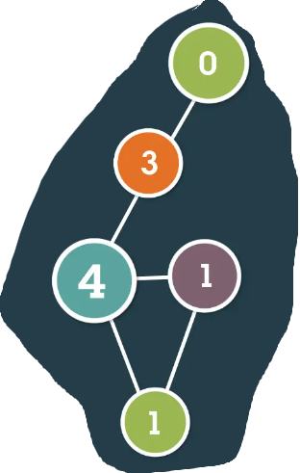
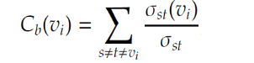
Graph Theory and its Applications
Centrality Recap
Betweenness Centrality: For node v_{i} , we compute the # of shortest paths between other nodes thru v_{i ,} which is given by
This is a measure of how often a node in the shortest path between two other nodes in the network.
People or organizations with high betweenness centrality score are often considered as Gatekeepers of the information and resources.
In this figure, the most central node falls in the shortest path between 4 other pairs of nodes in the network.

Slide 6
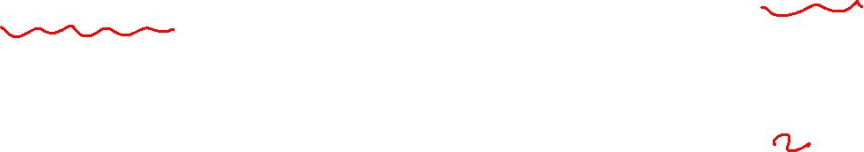
Graph Theory and its Applications
Centrality recap : how do you interpret ?
Generally, the 3 centrality types( degree, betweenness and closeness) will be positively correlated
When they are not, it probably tells you something interesting about the network.
Low
Degree
Low
Closeness
Low
Betweenness
High Degree
Embedded in cluster that is far from the rest of the network
Ego's connections are redundant - communication bypasses him/her
High Closeness
Key player tied to important/active alters who in turn provide connections
Probably multiple paths in the network, ego is near many people, but so are many others
High Betweenness
Ego's few ties are crucial for network flow
Very rare cell. Would mean that ego monopolizes the ties from a small number of people to many others.
https://www.researchgate.net/profile/Thomas-Valente-2/publication/44633441_How_Correlated_Are_Network_Centrality_Measures/links/00463522757b01e73f000000/How-Correlated-Are-Network-Centrality-Measures.pdf

Slide 7
Graph Theory and its Applications
What next?
We focused on actor level of social network i.e. centrality of an actor, actor’s ego network and various broker roles an actor can play in a network.
We move from actor level analysis to sub-group level analysis
Step a : Dyad (of two actors), Triad ( three actors)
Step b : larger sub-groups or components
Step c : even larger communities
Step d : we also look at measures of cohesion in the network at different level

Slide 8
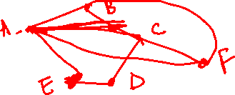
Graph Theory and its Applications
Clique and Dyad
The intuitive idea of a clique is a sub-set of a network in which the actors are more closely and intensely tied to one another than they are to other members of the network.
Not unusual for people in human groups to form "cliques" on the basis of age, gender, race, ethnicity, religion/ideology, and many other things.
The smallest "cliques" are composed of two actors: the dyad.
Mathematically, a clique is a subset( induced subgraph) of a network G which is complete.

Slide 9
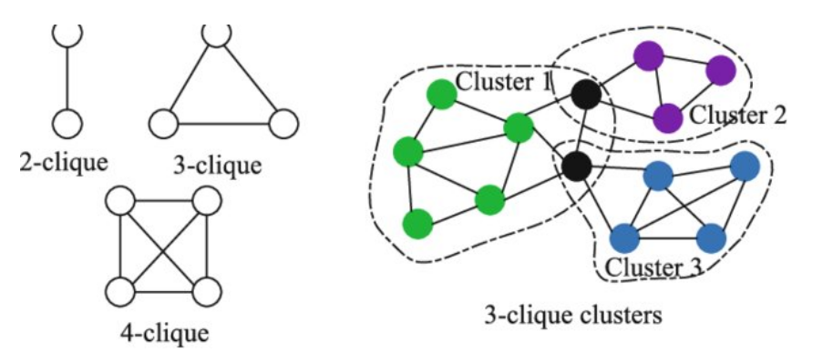
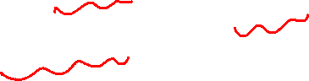
Graph Theory and its Applications
Clique and Triads
A clique is defined as a maximal complete subgraph of a given graph—
i.e., a group of people where everybody is connected directly to everyone else.
A clique consists of several overlapping closed triads
(A triad is a set of three actors, which also consists of three dyads.)

Slide 10
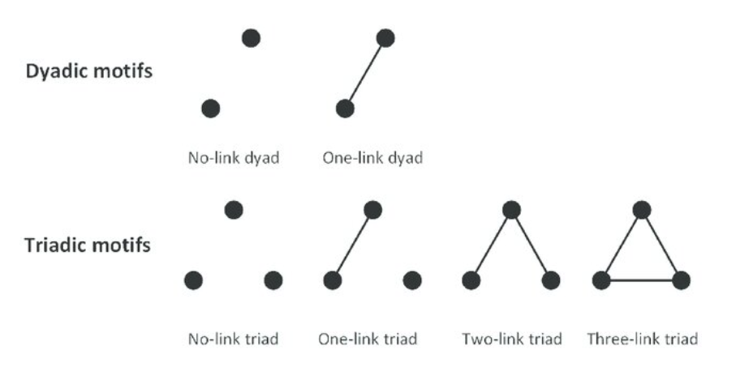
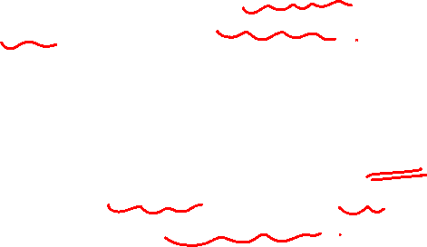
Graph Theory and its Applications
Dyad
A dyad consists of two actors and the ties linking the actors together.
Dyad study looks at how ties are initiated, continued and terminated
Much of the conceptualization and measurement of social networks takes place on the dyad level
Dyads can be understood in terms of kind of relational tie, direction of the tie and duration of the tie.

Slide 11
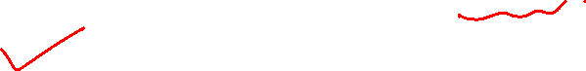
Graph Theory and its Applications
Dyad
Dyad census describes the properties of tie
Tie can be mutual
Tie can be asymmetric
Tie can be null ( both ends of the tie do not talk about a relation) i.e. essentially no tie
Also there are two more things about ties
Strength of a tie ( Granovetter’s strength of weak ties)
Multiplexity of tie ( a node can have multiple relations or ties with another node)

Slide 12
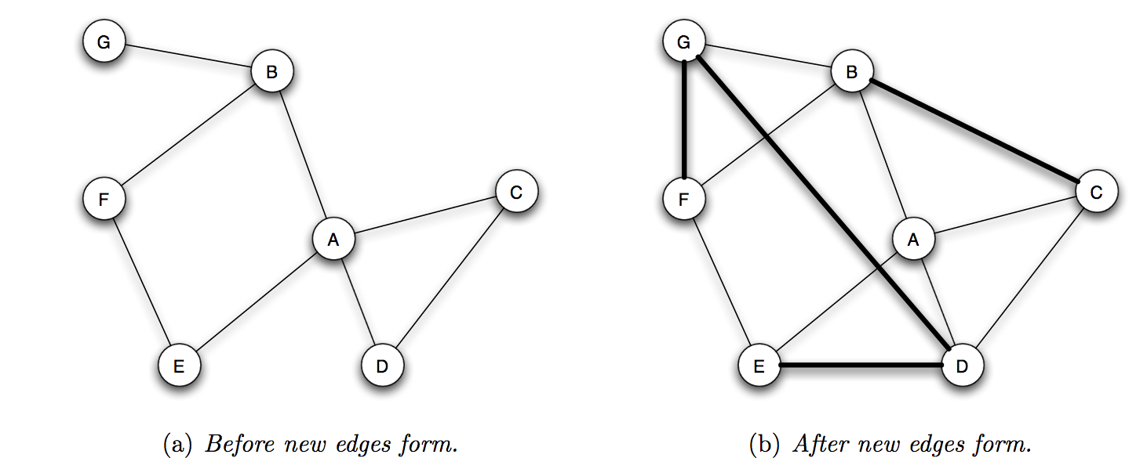
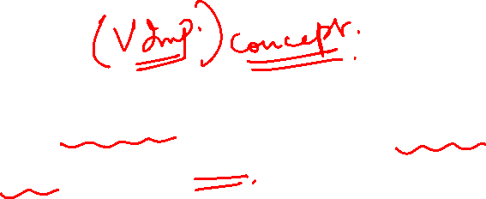
Graph Theory and its Applications
Triadic closure
If two people in a social network have a friend in common, then there is an increased likelihood that they will become friends themselves at some point in the future
Edges BC, FG, ED are results of triadic closure.
DG is not a result of triadic closure.

Slide 13
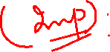
Graph Theory and its Applications
Types of Closure
1
Triadic closure
Common friend - A is friends with B and A is friends with C . So, C becomes friend of B
Foci/focal Closure
Two individuals become friends because of their common or shared interest .Two individuals applying for MS in the class and become close to each other. Probability of becoming friends when they have the same foci.
2
Membership Closure
If A is associated with the Rotary club and a friend B, then B also becomes member of Rotary club there is a tendency that B comes close to align the behavior of A.
3

Slide 14
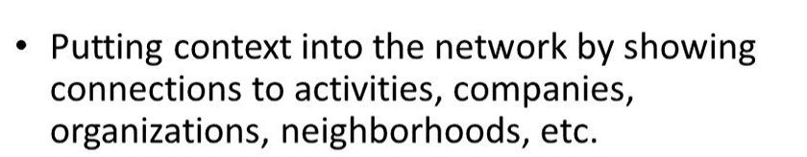
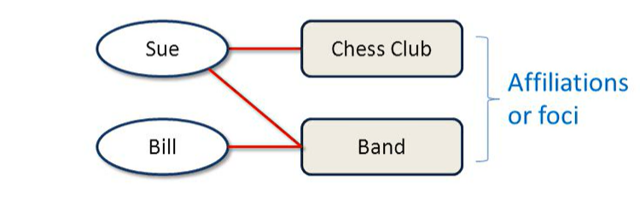
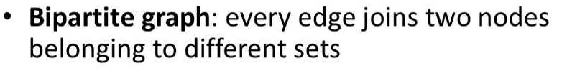
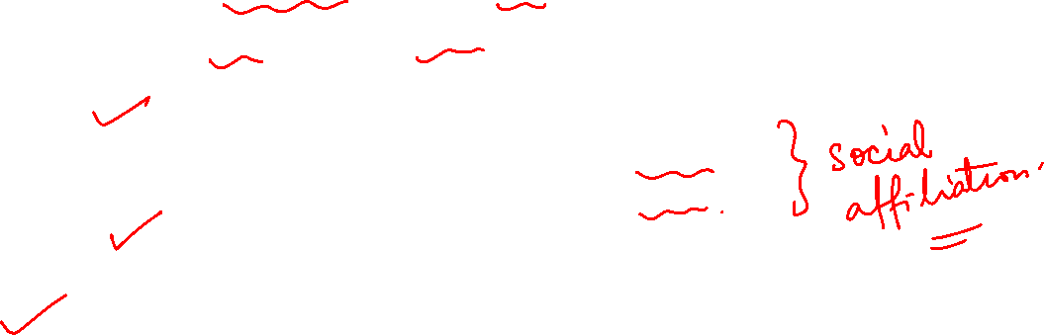
Graph Theory and its Applications
Social Affiliation

Slide 15
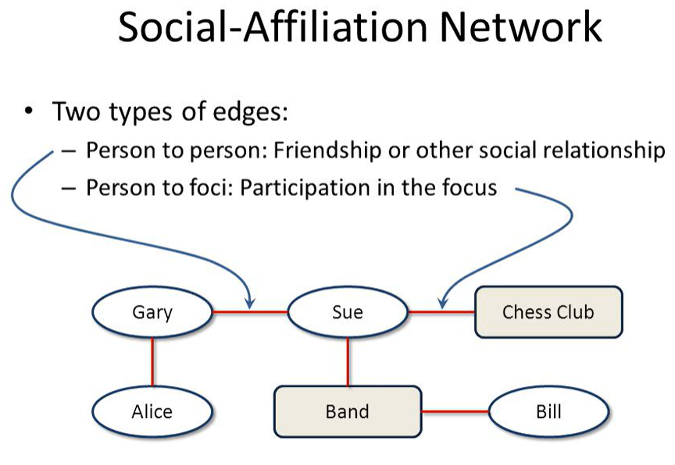
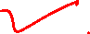
Graph Theory and its Applications
Social Affiliation

Slide 16
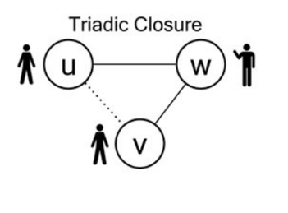
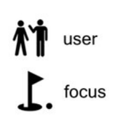
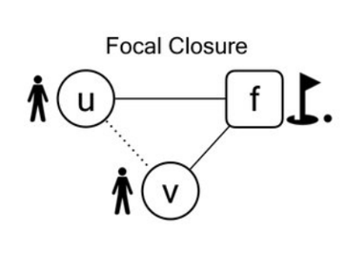
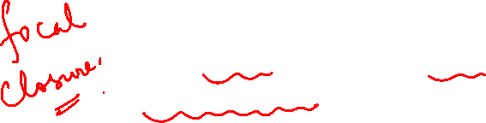
Graph Theory and its Applications
Back to…..Types of Closures
It is the tendency of two people to form a link when they have a focus in common.
This is an aspect of the more general principle of selection, forming links to others who share characteristics with you.

Slide 17
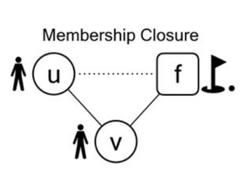
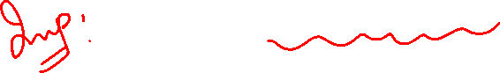
Graph Theory and its Applications
Back to…..Types of Closures
If u and v --- people, and f --- focus, then we have the formation of a new affiliation:
u takes part in a focus that her friend v is already involved in.
This is a kind of social influence, in which u’s behavior comes into closer alignment with that of her friend v.

Slide 18
Graph Theory and its Applications
Co-Evolution of Social Network
All three types of closure can happen together .
This is co-evolution of social-affiliation network
Bob introduces Anna to Claire
Rotary club introduces Anna to Daniel
Anna introduces Bob to Karate
Claire
Triadic closure (Bob may be the
reason for Claire and Anna to be friends
Bob
Anna
Focal closure
(Similar interest)
Membership closure
(same club or activity)
Rotary
Daniel
Focus

Slide 19
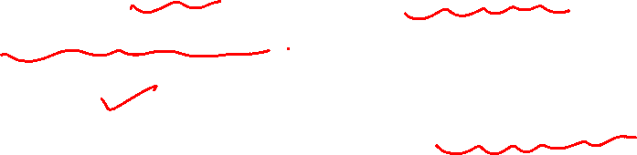
Graph Theory and its Applications
Triadic Closure and # of Common Friends
It is common that triadic closure happens when the nodes have many common friends.
The nodes are under an implicit pressure to become friends if they have many common friends.
It was observed that the probability to have triadic closure ( = to become friends or establish edge) grows linearly with the number of common friends !

Slide 20
Graph Theory and its Applications
Triadic closure and # of common friends
If p is the probability of A & B becoming friends when they have a common friend.
(1-p) is the probability of A & B not becoming friends when they have a common friend.
(1-p)^{k} is the probability of A & B not becoming friends when they have K common friends.
{ 1- (1-p)^{k} } is the probability of A & B becoming friends when they have K common friends.

Slide 21
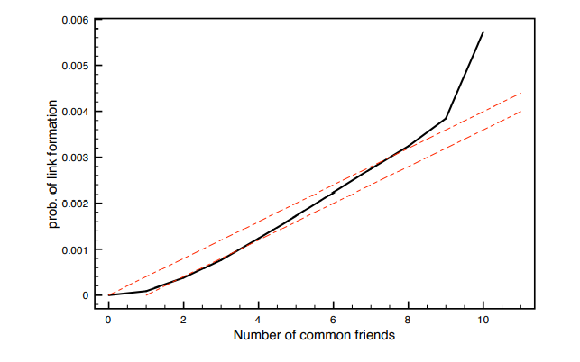
Graph Theory and its Applications
Triadic closure and # of common friends
The curve determined from the ‘email dataset’ is shown in the solid black line; the dotted curves show a comparison to probabilities computed according to two simple baseline models in which common friends provide independent probabilities of link formation.
Quantifying the effects of triadic closure
Paper link: http://languagelog.ldc.upenn.edu/myl/ldc/llog/k_w_Science.pdf

Slide 22
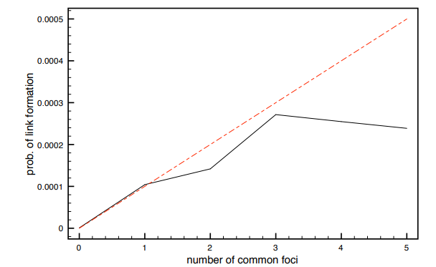
Graph Theory and its Applications
Triadic closure and # of common foci
Focal closure: What is the probability that two people form a link as a function of the number of foci they are jointly affiliated with?
Paper link: http://languagelog.ldc.upenn.edu/myl/ldc/llog/k_w_Science.pdf

Slide 23
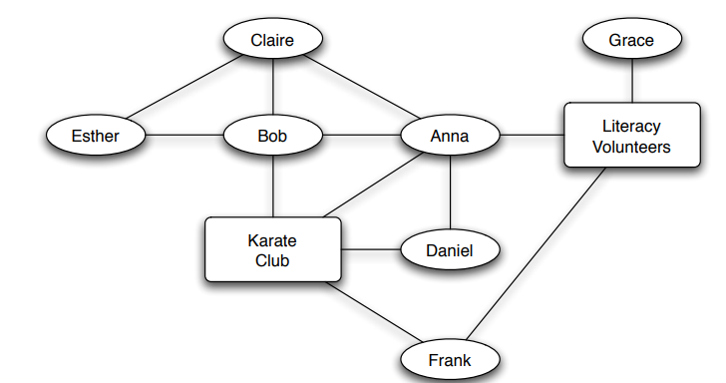
Graph Theory and its Applications
Triadic closure and # of common foci
Paper link: http://languagelog.ldc.upenn.edu/myl/ldc/llog/k_w_Science.pdf

Slide 24
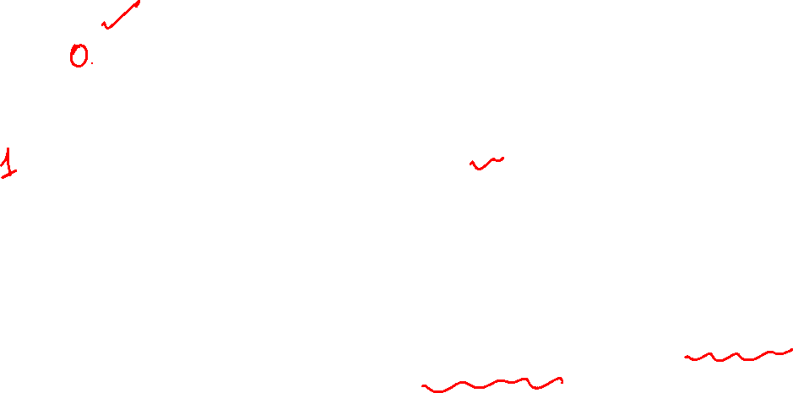
Graph Theory and its Applications
Triadic closure and density of ego’s friendship network
Triadic closure leads to these scenario
None
2 extreme scenarios (my friends do not know each other and each of my friend knows each of my other friends)
The total # of friendship (pair) possible amongst my friends= 10
Out of that only n are there in the 3rd diagram
Ratio= n/10 measures the strength of my friendship network.
It is 0 when none of friends know each other and 1 when every pair know each other
All
Some

Slide 25
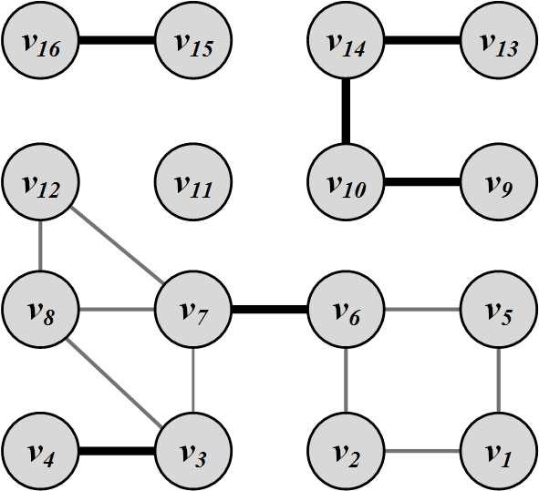
Graph Theory and its Applications
Bridges
Bridges are edges whose removal will increase the number of (connected) components
Connected graph – there is a path between all nodes

Slide 26
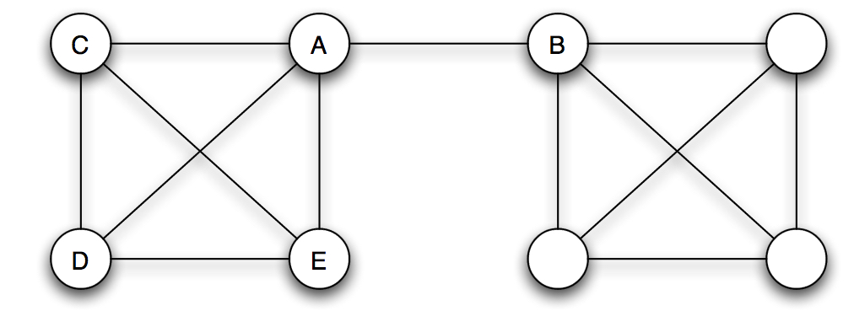

Graph Theory and its Applications
Bridge and local bridge
AB is a bridge because removal of AB partitions the network into separate components

Slide 27
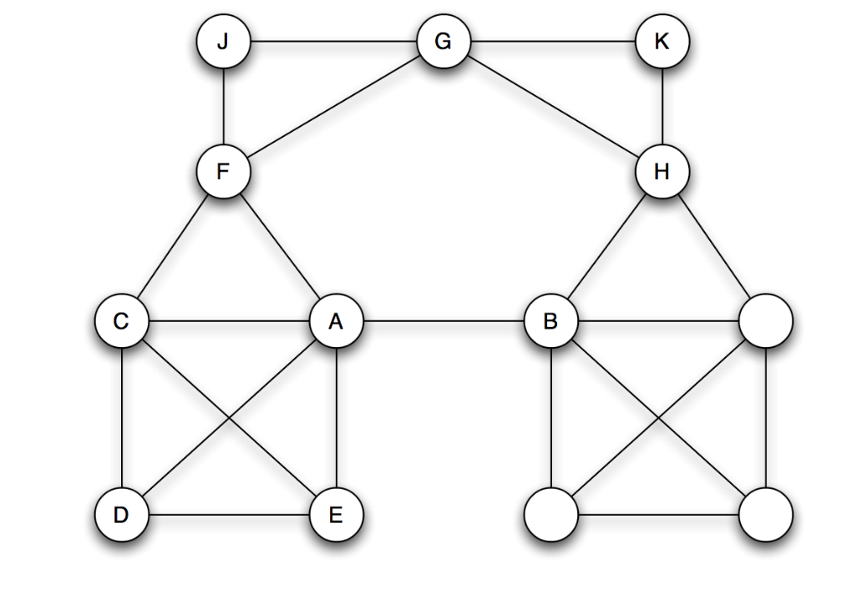
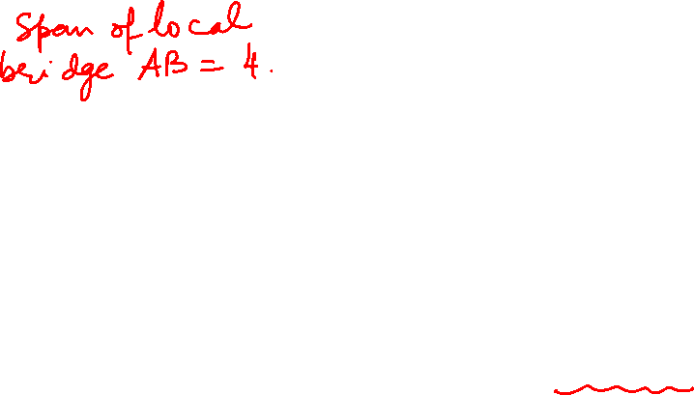
Graph Theory and its Applications
Bridge and local bridge
AB is a “local bridge”. The removal of AB increases the distance between A, B but does not partition the network. Local bridge is more common than bridge
An edge joining two nodes A and B in a graph is a local bridge if its endpoints A and B have no friends in common.
The span of a local bridge is the number of hops it takes to connect the two end nodes of the local bridge if the edge is removed from the graph
Local Bridge

Slide 28
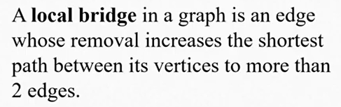
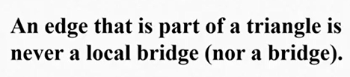
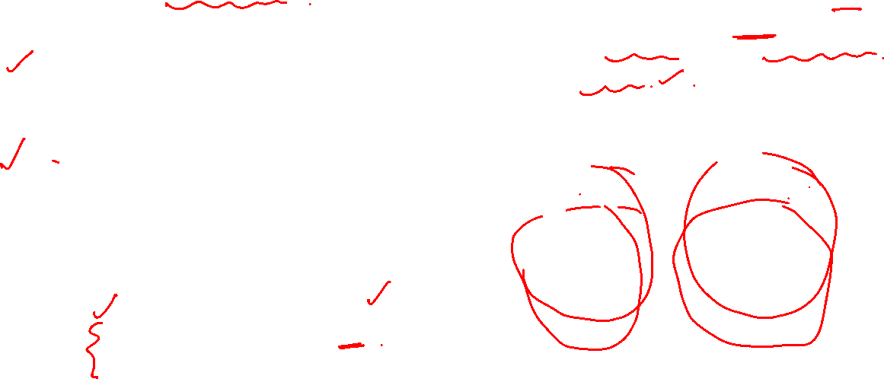
Graph Theory and its Applications
Bridge and local bridge – what roles they play ?
Bridges allow diffusion of information between otherwise disconnected communities. They are rare to find
Local bridges bring otherwise distant communities together
Local Bridge

Slide 29
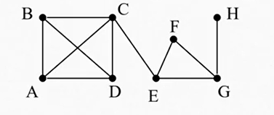
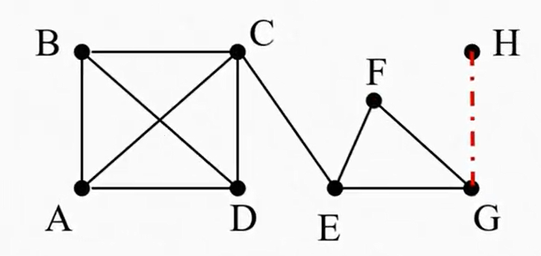
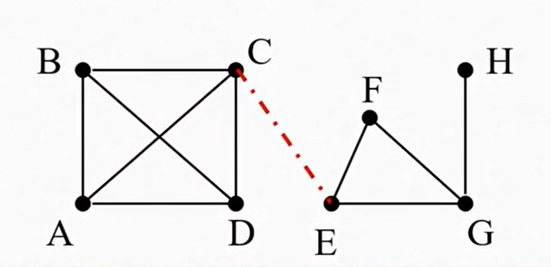
Graph Theory and its Applications
Bridge and local bridge
Identify the bridges:
CE and HG

Slide 30
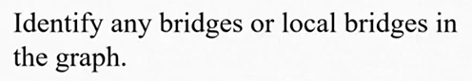
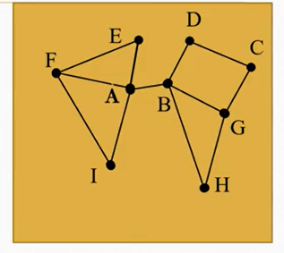
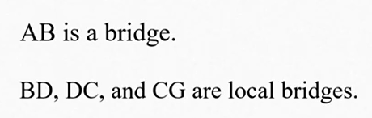
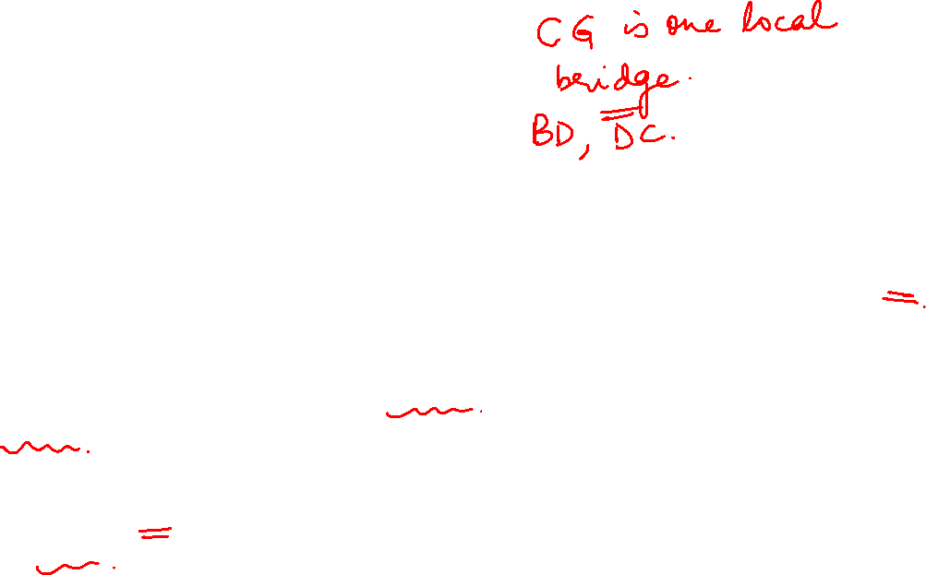
Graph Theory and its Applications
Bridge and local bridge
Note that: A bridge can never be a part of a circuit.
A local bridge can never be a part of a triangle.

Slide 31
Towards measuring cohesion- Shortest path, Density and Diameter

Slide 32
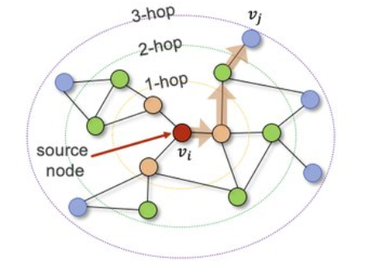
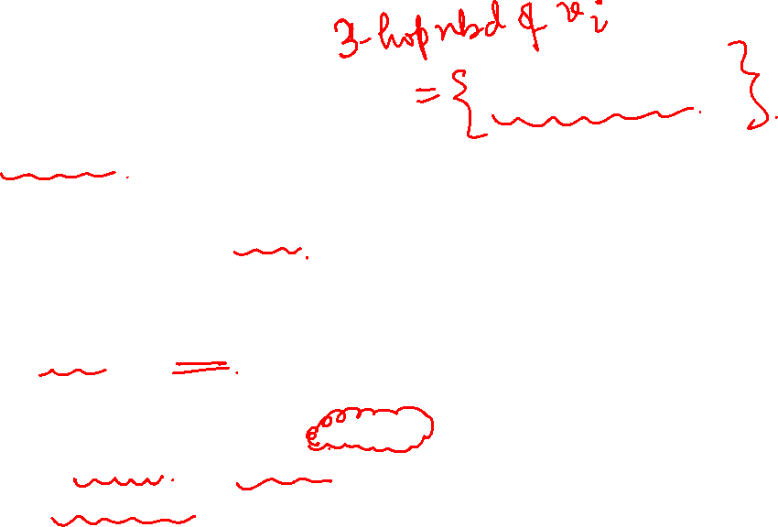
Graph Theory and its Applications
Shortest path and n-hop neighborhood
Shortest Path is the path between two nodes that has the shortest length.
We denote the length of the shortest path between nodes v_{i} and v_{j} as
The concept of the neighborhood of a node can be generalized using shortest paths.
An n-hop neighborhood of a node is the set of nodes that are within n hops distance(or shortest path) from the node.

Slide 33
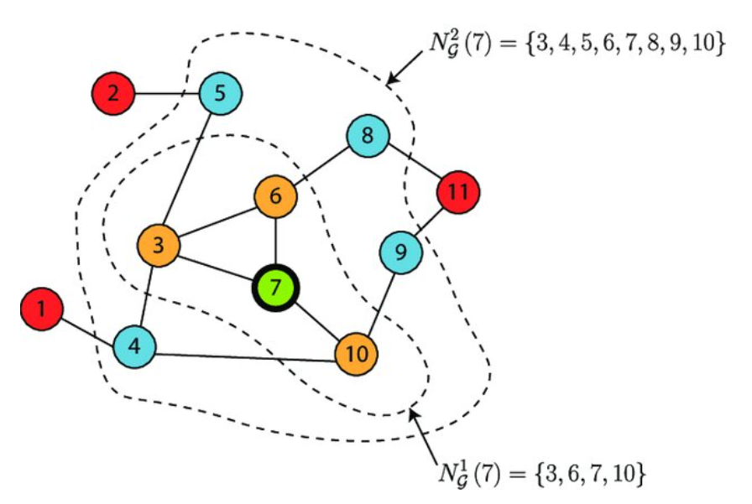
Graph Theory and its Applications
Shortest path and n-hop neighborhood
Node neighborhood using shortest_path distance.
Neighbors around node 7 are color-coded based on their corresponding shortest_path distance layer.
Orange color represents directly adjacent nodes, blue color highlights nodes at 2 hops from node 7, and red color labels the remaining nodes in the graph.
(PDF) Geometric Affinity Propagation for Clustering with Network Knowledge (researchgate.net)

Slide 34
Graph Theory and its Applications
Finding shortest path from the adjacency matrix
The adjacency matrix is exactly what its name suggests -- it tells us which actors are adjacent or have a direct path from one to the other.
Now suppose that we multiply this adjacency matrix by itself (i.e. raise the matrix to the 2nd power or square it).
This matrix (the adjacency matrix squared) counts the number of pathways between two nodes that are of length two when the adjacency matrix is binary ( 1 or 0).
Similarly, the matrix(the adjacency matrix cubed) counts the number of pathways between two nodes that are of length three.
Can be proved inductively that it holds true for power n
Introduction to Social Network Methods; Chapter 5: Using Matrices (ucr.edu)

Slide 35
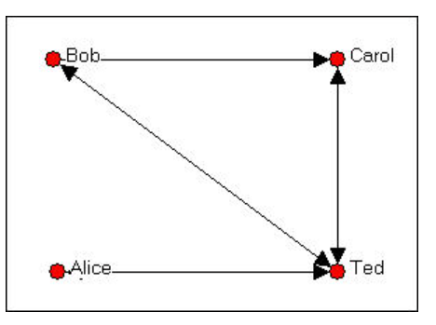
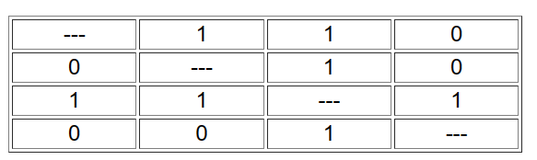
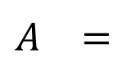


Graph Theory and its Applications
Finding shortest path from the adjacency matrix
$$A^{}=$$
The adjacency matrix tells us how many paths of length one are there from each actor to each other actor.
Introduction to Social Network Methods; Chapter 5: Using Matrices (ucr.edu)

Slide 36



Graph Theory and its Applications
Finding shortest path from the adjacency matrix
$$A^{2}=$$
Bob is connected to each of the other actors by a pathway of length two; and that there is no more than one such pathway to any other actor.
Actor Ted is connected to himself by pathways of length two, 3 times( Ted to Carol and back to Ted( length=2), ( Ted to Bob and back to Ted ( length of pathway=2), Ted to Alice and back to Ted ) . This is because actor T has reciprocal ties with each of the other three actors.
There is no pathway of length two from T to B (although there is a pathway of length one).
Introduction to Social Network Methods; Chapter 5: Using Matrices (ucr.edu)

Slide 37

Graph Theory and its Applications
Finding shortest path from the adjacency matrix - 2
After treating self ties as zero, we can do A² and it will count number of pathways of length 2. A³ will count number of pathways of length 3.
Measuring number and length of pathways between two actors is very useful.
Networks that have few or weak connections (larger length) may display low solidarity, tendency to fall apart , slow response to any stimulus ..
Actors who have short pathways to more actors are more influential or central figures !!
Introduction to Social Network Methods; Chapter 5: Using Matrices (ucr.edu)

Slide 38
Graph Theory and its Applications
Finding shortest path from the adjacency matrix - 3
Assume A is the adjacency matrix
That is, the shortest path length between nodes i and j can be found by finding the smallest n such that the ij^{th} entry A^{n} is positive, and then that entry is the number of shortest paths between those nodes.
Introduction to Social Network Methods; Chapter 5: Using Matrices (ucr.edu)

Slide 39
Graph Theory and its Applications
Towards measuring cohesion- Density

Slide 40


Graph Theory and its Applications
Density – proportion of dyadic connections that is present
Measuring the density of a network gives us a ready index of the degree of dyadic connection in a population.
For binary data (symmetric matrix), density is simply the ratio of the number of adjacencies that are present divided by the number of pairs - proportion of all possible/potential dyadic connections.
$$Density=\frac{\text{the} \text{number} \text{of} \text{edges}\text{ |}\text{E}\text{| }\text{that} \text{graph} \text{G} \text{has}}{\text{the} \text{maximum} \text{it} \text{can} \text{have} C_{2}^{V}}$$
An ideal, fully connected network would have a density of 1.00

Slide 41

Graph Theory and its Applications
Density – proportion of dyadic connections that is present
There are 13 nodes and 17 known social connections
But with 13 nodes there are 78 ( C(13,2)) possible connections. This means the density of the network is 17/78 = 0.22

Slide 42
Graph Theory and its Applications
Density – proportion of dyadic connections that is present
Criticism :
What if the density score is relatively high but this high score can come mainly from ties through a single person ?
This scenario typically suggests the presence of a "hub" or "broker" in the network who plays a central role in connecting various individuals.
Decreasing density through increasing network size ?
Common experience confirms that the density of networks goes down as the size of the group increases. Research suggests that above a few hundred nodes the maximum density will never be > 0.5.
Increasing density through number of cohesive subgroups ?
Increasing density through the number of cohesive subgroups in a network means that you are aiming to enhance the overall density of connections or relationships within the network by creating or identifying smaller, tightly interconnected subgroups or clusters of nodes.

Slide 43


Graph Theory and its Applications
Cohesive Subgroups: FYI
Cohesive subgroups in a network refer to distinct and internally tightly interconnected clusters or groups of nodes within the larger network.

Slide 44

Graph Theory and its Applications
Towards measuring cohesion- Diameter

Slide 45


Graph Theory and its Applications
Diameter and average length( distance)
Other than Density, an alternative means for exploring network level cohesion is through network diameter and average path length.
Diameter: the maximum distance between any pair of nodes in the graph.
Diameter is the maximum geodesic (shortest path)
If diameter is small, then everyone is fairly close to each other
Network is probably more cohesive

Slide 46

Graph Theory and its Applications
Diameter and average length( distance)
Average distance— is the average distance over all pairs of nodes in the graph.
Or average geodesic as an indicator for how close actors are to one another.

Slide 47
Graph Theory and its Applications
Degree distribution and the degree Assortativity

Slide 48



Graph Theory and its Applications
Degree Distribution
Degree Distribution: Prob dist. Of the degrees over the whole network.
In very large graphs, distribution of node degrees (degree distribution) is an important attribute to consider.
In a graph with n nodes, p_{d} is defined as
p_{d} is the probability that a randomly chosen node has degree d.

Slide 49
Graph Theory and its Applications
Degree distribution

Slide 50


Graph Theory and its Applications
Entropy of degree distribution
Since this is a probability distribution, the entropy ( that encodes the extent of randomness) is
$H=−\sum_{d=1}^{n−1}{{(P}_{d})log⁡(P_{d}}$)
High entropy indicates that the distribution is relatively random.
Network entropy is a disorder measure derived from Information Theory to describe the level of randomness and the amount of information encoded in a graph.

Slide 51



Graph Theory and its Applications
Entropy of degree distribution
What will be the entropy H for a k-regular graph ( example – clique degree is n-1 for a graph of n nodes)
(A graph is called regular graph if degree of each vertex is equal. A graph is called K regular if degree of each vertex in the graph is K.)
For degree value k, the probability will be 1 and for the rest it is 0. Hence, entropy will be zero !
Such a network will have very little diversity
Hence calculating entropy delivers more information about the network topology
$$p_{1}=0, p_{2}=0,$$
$$p_{3}=\frac{6}{6}=1$$
$H=−\sum_{d=1}^{n−1}{{(P}_{d})log⁡(P_{d}}$)
$=$ $p_{1}$log $p_{1}$+ $p_{2}$log $p_{2}$+ $p_{3}$log $p_{3}$=0

Slide 52

Graph Theory and its Applications
3-regular graph: Examples

Slide 53

Graph Theory and its Applications
Degree Assortativity
Assortativity is something synonymous to homophily
Assortativity is a preference for a network's nodes to attach to others that are similar (assortative) or different (disassortative) in some way.
In a study, 1958 couples in the city of San Francisco identified their race and it was clear that there is assortativity between Black, Hispanic, White and others
Degree assortativity - Estimate degree correlation (rich goes with rich)
Consider the average degree of neighbors of a node with degree k. If we plot all such nodes (node degree k with average degree of neighbors),
Increasing slope → assortative → high degree node goes with high degree node
Decreasing slope → disassortative → high degree node goes with low degree node

Slide 54

Graph Theory and its Applications
Assortative mixing
Let’s now look at how assortative the network is.
This measure is known as assortative mixing coefficient r.
In case of perfect assortativity we’ll have only black will go with black, Asian will go with Asian etc in the previous example.
So, if we have a matrix of the association and the matrix values are normalized with total number of relations (based on race), in the best case the diagonal will have a value of 1.
Let N be a network with n nodes, each of which has a “type” belonging to some set T. We say that N is “assortatively mixed” if nodes tend to have the same types as their neighbors. For example, if N is a social network and T is a set of interests, then assortative mixing could arise because friends tend to share interests.

Slide 55


Graph Theory and its Applications
Assortative mixing
We use the concept of correlation coefficient to define r and that is the assortative mixing coefficient
If r=1 , it is perfectly assortative ( only the diagonal elements exist)
If all the diagonal elements of the above matrix are 0, then we have r=-1 and we have a perfectly disassortative network
Degree assortativity can be used for different attributes of the node ( in previous case, it was race)

Slide 56


Graph Theory and its Applications
Rich Club
However, we do NOT have uniform degree assortativity in practical network.
We typically see a Rich Club i.e. the nodes which are having many connections are clustered together
Example – all famous actors work together to produce Bollywood hits ; famous researchers work together to produce seminal work
Rich club coefficient for a threshold degree k is defined as
Suppose the number of nodes with degree > threshold k is n
Rich Club Coefficient =$\frac{\#of edges between these n nodes}{\max{\# of edges between these n nodes}}$

Slide 57


Graph Theory and its Applications
Rich Club
A network with a rich club. The set of nodes in the center have high degree and are densely intra-connected.

Slide 58
THANK YOU
Dr. Arti Arya
Department of Computer Science and Engineering

